Slide 1
Lesson 4– Homework review

Slide 2


Slide 3
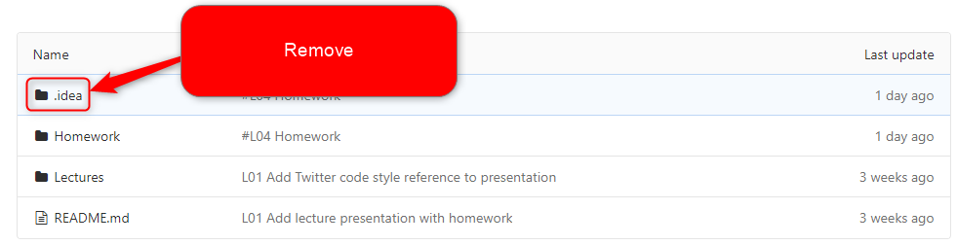
Do not track non business code

Slide 4


Commit atomically

Slide 5
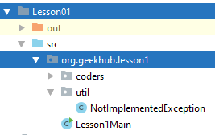
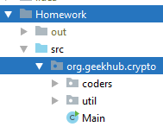
Merge prod

Slide 6
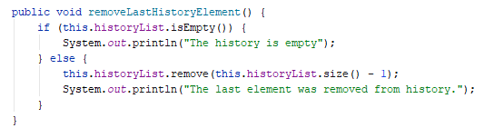
Single Responsibility: remove vs print

Slide 7
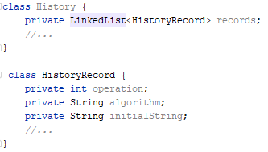
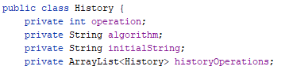
Single Responsibility: container vs entry

Slide 8
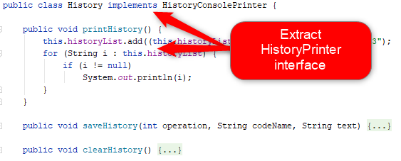
Single Responsibility: container vs printer

Slide 9
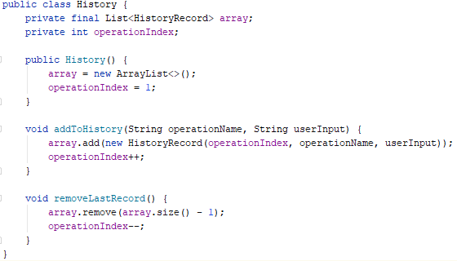
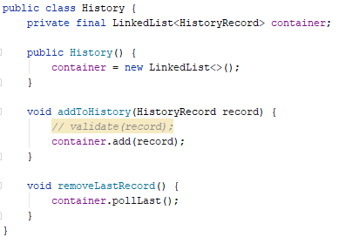
Use LinkedList advantages

Slide 10
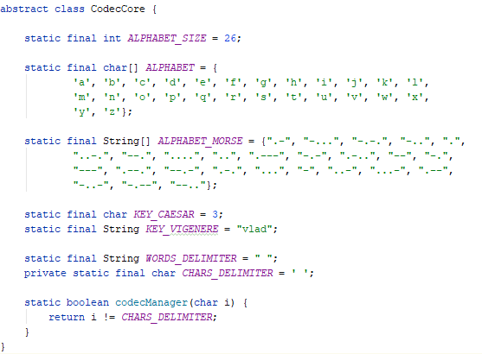
Avoid inheritance

Slide 11
Apply recommendations from personal feedbacks before starting next homework

